Slide 1
CONTROL AND QUALITY MANAGEMENT

Slide 2
Contents
Concept, process and types of control systems
Characteristics of effective control system
Quality control systems- Concept of quality
Total Quality management (TQM) – Concept and tools
Deming management – Principles and techniques

Slide 3
Concept
It is the end function of management and aims at regulating organizational activities by finding deviation between actual performance and the standards of performance or targets. If the deviation is positive, or within desirable limits, no corrective action is required, but if the deviation is negative and beyond the desirable limits, corrective action is taken in planning and/ or implementation stages.
According to Judith G Bulin, “Controlling is the process of comparing actual results with planned objectives and determining whether to make adjustments.”
To sum up, controlling is the process of comparing actual results with some predetermined standards, finding deviations and their reasons and applying corrective measures in organizational activities.

Slide 4
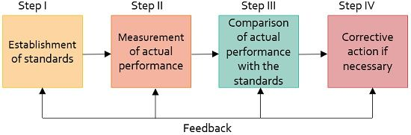
Control process

Slide 5
Elements of control process
Set performance standards (planning phase): Standards are the criteria against which actual performance are measured. They should be verifiable. The standards may be quantitative, i.e. physical, monetary, cost, time, capital, revenue or non-quantitative like quality standards. Standard serve basis for control. Therefore, they should be set very carefully.
Measurement of performance (Implementation phase): The second step in control process is to measure the actual level of performance. Managers must measure the level of performance on a regular basis in order to identify weakness and strengths on time.
Comparison of actual performance with standards: There are two steps in comparison as
Finding the extent of deviation
Identifying the causes of deviation
The major or significant deviations should be analyzed thoroughly to identify the causes. The causes may be unachievable standards, inappropriate plan and policies or the poor execution of plans.

Slide 6
Cont…
4. Taking corrective actions: In this step, as soon as the deviation is reported, it is the duty of managers to take corrective actions. Corrective actions may include:
Review of plans and goals, and changes therein
Changes in assignment of tasks
Changes in organization structure
Changing motivation and leadership approaches
Changes in rules, policies, procedures, etc.
Changes in resources, working conditions etc.

Slide 7
Types of control
The main purpose of control system is to regulate the organizational activities without serious losses and damages. Depending on the time at which control is applied, control is of three types:
Pre-control system: It is also known as free-forward control. It is the intelligent anticipation of problems and their prevention than after the fact reaction. This control system takes place before the work is performed. It is thus a more aggressive and proactive approach to control. In order to ensure pre-control, management creates rules, policies, and procedures. Establishing a uniform procurement system, preparing job specifications, policies, rules, etc. to regulate the activities and behaviors of employees are the example of it.
Concurrent control system: This is also called gatekeeper control or real time control. It consists of monitoring ongoing activities to ensure they are consistent with standards. The air traffic controller of an aircraft who directs/adjusts the aircrafts movements is an example of concurrent control system. In organization, for example, the quality of products is checked while in process. If some defects are found, it is sent back for repair or reprocessing and also the use of raw materials is monitored regularly.

Slide 8
Cont…
Post control system: This is also called feedback control or post-control. It is a post examination of events, the purpose of which is to improve performance in future. Analyses of cost, productivity, profitability, employee performance, etc. at the end of the year are some of the examples of it. All these control systems are relevant to the managers. Pre-control help management to avoid mistakes, concurrent control enables to rectify mistakes as they are being made; and post control keeps them apart from repeating mistakes.

Slide 9
Essentials of effective control systems
Characteristics/essentials of effective control system:
Stonner (1978) has given different characteristics of effective control system as follows
Focused: Control system should be focused on points where deviations could occur the most.
Accurate: Information provided by the control system must be reliable and accurate.
Simple: Control system must be simple. It should not be too long and time consuming.
Timely: To maintain work standards, control should be done at right time intervals
Flexible: Control system should not be rigid. It should be able to change according to the change in external and internal environment.
Realistic: Control system must be realistic. It should not make unrealistic high standards.
Acceptable: The control system must be well accepted by the employees in the organization.
Minimal: Control system must have a huge dimension. It should be able to see the work done and maintain standards.
Objective and comprehensive: The control system must be objective and clearly understood by the employees.

Slide 10
Quality management
Quality simply means freedom from defects but there is no univocal definition of quality. Different scholars have defined quality in different ways. It is generally understood and explained by the perception of excellence viewed by the customers to satisfy their needs.
According to Philip Crosby, “Quality is conformance to requirements.”
Likewise, according to Tom Peters, “Quality a it is used in management means more than or better than average product at a good price.”

Slide 11
Importance
More Consistent Products and Increased Efficiency
Greater Customer Satisfaction
Lower Costs, Increased Profits
Reduced Risks
Fewer Human Errors
Keep Up With the Competition

Slide 12
Total Quality Management (TQM)
It is a continuous and comprehensive approach to improve product quality and thereby customer satisfaction.
According to Arthur R. Tenner and Irving DeToro, “TQM is creating an organizational culture committed to the continuous improvement of skill, teamwork, process, product and service quality and customer satisfaction.”

Slide 13
Tools/Techniques for TQM
Benchmarking: Benchmarking is the process of comparing the cost, time or quality of what one organization does against what another organization does. By observing the efficient processes and products of competitors, organization can take necessary steps to improve the own quality.
Benchmarking involves time, cost, and effort. Sometimes, it may be difficult to locate the best practices of competitors. But, the use of internet and the websites of concerned organizations has made it easier.
Outsourcing: It is the process of subcontracting services and operations to other firms that can do them cheaper or better or both. If those areas are clearly identified and outsourced, organizations can have high quality operations at reasonable costs.
ISO 9000: ISO 9000 refers to a set of quality standards created by ISO (International Organization for Standardization). ISO standards cover product testing, employee training, record keeping, supplier relations and policies and procedures. Business firms, which comply with the guidelines of ISO 9000, are considered as qualitative and environmentally responsive.

Slide 14
Cont…
Speed: Speed or quick production and delivery of goods and services is another important tool for TQM. Speed production and delivery can be achieved through
Minimizing the number of approvals needed to do something
The use of different types of work teams
Developing and adhering to a schedule
Integrating speed into the organization’s culture
In present day of fast moving world, faster organizations are more likely to be the winners, slow one the losers.
Employee empowerment: Employee empowerment is a term used to express the ways in which non-managerial staff can make autonomous decisions without consulting a boss/manager. These self-willed decisions can be small or large depending upon the degree of power with which the company wishes to invest employees. Employee empowerment can begin with training and converting a whole company to an empowerment model. Conversely it may merely mean giving employees the ability to make some decisions on their own.
Other tools: Give it yourself according to the class (draw figure and describe in short)

Slide 15
Other tools for TQM
Flowchart
Check sheet
Histogram
Pareto chart
Scatter diagram
Fish bone diagram
Control charts

Slide 16
Cont…
Flow chart:
Check sheet: It is taken as the first step in analysis of quality problems. It is simply a form used to record the frequency of defects as they occur
Histogram: Histograms show the range of values of a measurement and the frequency with which each value occurs.
Scatter diagram: Scatter diagrams are used to show the relationship between two variables. If the two items are closely related, the data points will form a tight band
Pareto analysis: It is based on 80-20 rule. The analysis say that 80% of the defects are caused by 20% of the causes
Fish bone diagram: Show cause and effect relationship
Control charts: Graphical presentation of data over time that show the upper control limit, lower control limit and control limit. If the samples go outside the control limits then the process is stopped and controlled

Slide 17
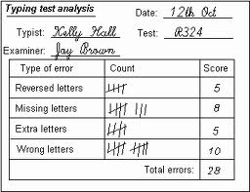
Check Sheet

Slide 18
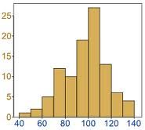
Histogram
Frequency
Repair time (minutes)

Slide 19
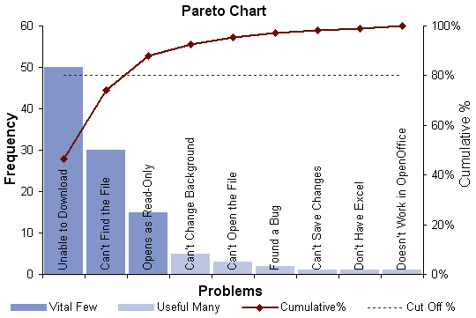
Pareto Analysis

Slide 20
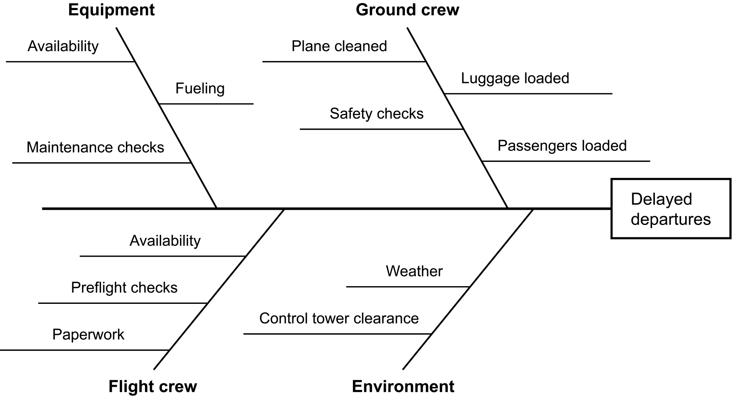
Fish Bone Diagram(Ishikawa Diagram or Cause –and-effect Diagram)

Slide 21
Deming mangement
Concept of Deming Management: W. Edwards Deming, an American mathematician, advocated the way to achieve the product quality by the continuous application of certain principles and techniques. According the Deming, top management has the primary responsibility for achieving product quality. Deming management is in fact, the application of Deming’s principles and Techniques to management.
Deming’s Quality Management Principles
Deming has indicated the following principles of quality management:
Quality improvement: Quality improvement drives the entire economy
Customer focus: The customer always comes first
Fix the system: A person should not be blamed for quality problems; a system of quality management must be fixed.
PDCA cycle: Plan-Do-Check-Act (PDCA) should be enforced
Continuous improvement: Continuous improvement should be sought through extensive training, leadership, teamwork, and self-improvement.

Slide 22
Cont…
Note: The PDCA cycle has four categories as Plan, Do, Check and Act as follows
Plan: Plan desired and important changes using available or observed data. Is a pilot test needed?
Do: Implement the change or do a small scale test
Check: Check/observe what happened in the change or the test
Act: After studying the results, act on the lessons learnt. Can any predictions be made as a basis for new methods?

Slide 23
Techniques
Deming has proposed fourteen techniques for the continuous improvement of quality. He believes that the delicate interaction of materials, machines and people determines productivity, quality and competitive advantage. A brief description of these techniques can be given as below:
Constant purpose: Purpose of management must be constant. Quality should be the purpose of organization instead of profit.
New philosophy: Organizations must adopt new philosophy for quality improvements. It is not enough that defects are minimized, they should be eliminated.
Give up ‘quality by inspection’: Quality come not from inspection but from improvement of the process. Therefore, inspection for faulty products is un-necessary if quality is built in from the very beginning.
Seek continuous improvement: Constantly improve production processes for greater productivity and lower costs.
Train everyone: Make sure people have a clear idea of how to do their job. Informal learning of a new job from coworkers may lead to bad work habits.

Slide 24
Cont…
Avoid the constant search for lowest cost suppliers: Build long term, loyal and trusting relationships with single supplier.
Provide real leadership: Provide leadership not only by telling but also by participating and delegating.
Drive out fear: Workers should feel free to express their views. Therefore, a culture of openness, where employees are not afraid of telling the truth, remains essential.
Promote teamwork: The barrier between functional departments is counterproductive. They must work in teams to tackle problems. Let employees formulate their own slogans
Eliminate slogan and targets: The organizations should eliminate the use of slogans, posters, and exhortations demanding zero defects and new levels of productivity without providing mechanisms to attain them. If they get good leadership and encouragement, the scoreboard will take care of itself.
Eliminate numerical quotas: Quotas or numerical goals encourage employees to focus on quantity often at the expense of abolishing unwanted competition, goal conflicts, lack of resources, fear of mistakes etc.

Slide 25
Cont…
Education and training: This principle is concerned with providing vigorous program of education and self-development. Continuous improvement through education and training should be the number one career objective for everyone in the organization.
Transformation is everyone’s job: All involved in organization should work honestly for its transformation. In other words, this entire organization must work together and understand all quality management principles to accomplish transformation.

